Slide 1
Let’s Begin Python
Lesson 3.1
Notes:
1.1

Slide 2
Class Objectives
By the end of today’s class you will be able to:
Perform Python 3 installation.
Navigate thru folders and files via terminal / git-bash.
Create Python scripts and run them in terminal /git-bash.
Understand basic programming concepts in Python.
Notes:
1.1

Slide 3
Without further ado
The Mighty Python!!!
Notes:
1.1

Slide 4

Few things to note before we move forward...
We are diving in into a more traditional programming language, Python.
The fundamental concepts still the same, and the most significant change in this transition period from VBA will be only the syntax.
Check your Slack.
Notes:
1.1

Slide 5
Terminal
Notes:
1.2

Slide 6
Some basic commands
cd (Changes the directory).
cd ~ (Changes to the home directory).
cd .. (Moves up one directory).
ls (Lists files in the folder).
pwd (Shows the current directory).
Mkdir <FOLDERNAME> (Creates a new directory with the FOLDERNAME)
touch <FOLDERNAME> (Creates a new file with the FILENAME).
rm <FOLDERNAME> (Deletes a file).
rm -r (Deletes a folder, make sure to note the -r).
open . (Opens the current folder on Macs).
explorer . (Opens the current folder on GitBash).
open <FILENAME> (Opens a specific file on Macs).
explorer <FILENAME> (Opens a specific file on GitBash).
Notes:
1.2

Slide 7

What time is it? It's showtime!
Nope! It’s time to check your
SLACK!
Notes:
1.2
Slack out CommonCommands.txt for students to use as a reference. Answer any questions up until this point.

Slide 8
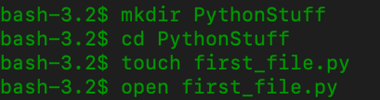
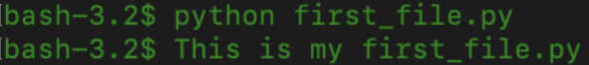
Common Commands
Notes:
1.2
Note - image on slide 8 is for mac - and image on LP is windows -
This is basic terminal navigation, from here show how students can edit Python files and run in terminal.
Create and navigate into a PythonStuff folder on the desktop.
Create and open first_file.py using the text editor.
Add print("This is my first Python file") and save the code.
Return to the terminal and run the file using python first_file.py.
Explain that python <FILENAME>.py tells the computer that this is a python file and to run the code contained within.
Repeat again with second_file.py using the code print("This is my second python file").

Slide 9
Notes:
1.3
Return to the lesson plan and continue with the instructions for the remainder of the activity.

Slide 10
Activity: Terminal
In this activity, you will dive into the terminal, create three folders, and a pair of Python files which will print some strings of their own creation to the console.
10 Minutes
Notes:
1.3

Slide 11
Activity: Terminal
Instructions:
Write and execute the following commands:
Create a folder called LearnPython.
Navigate into the folder.
Inside LearnPython create another folder called Assignment1.
Inside Assignment1 create a file called quick_python.py.
Add a print statement to quick_python.py.
Run quick_python.py.
Return to the LearnPython folder.
Inside LearnPython create another folder called Assignment2.
Inside Assignment2 create a file called quick_python2.py.
Add a different print statement to quick_python2.py.
Run quick_python2.py.
Notes:
1.3

Slide 12
Notes:
1.4
Check LP or see below:
Open TerminalGamesSolved.sh and work through the code in the solution in the terminal while also showing the results on the computer.
Open slideshow and use slide 12.
Key points to cover during the review of this activity:
mkdir will make the directories.
cd is changing into them.
touch will create the file (it will be empty).
To add lines of code to these files simply edit them within a text editor.
Afterwards, using python quick_python.py will run the code. Be sure to remind the students on Macs to run the which python command to make sure they are using Anaconda's Python instead of the default Mac version, as it is Python 2.7, not the required Python 3.7.6.
cd .. will take you back one level to the LearnPython folder where the process can be repeated.
cd ../.. will take you back two levels.
Show the students, by example, the benefit of using the tab key for autocompletion as they are typing the path to a directory or running a file.
Show the students, by example, the benefits of using the up and down arrow keys instead of typing commands over and over or using the tab key.
Finally, show the students how to get the history of the commands they used by typing history on the command line.

Slide 13
Everyone Do: Check Anaconda installation
In this activity, we will check if Anaconda is properly installed.
5 Minutes
Notes:
2.1

Slide 14
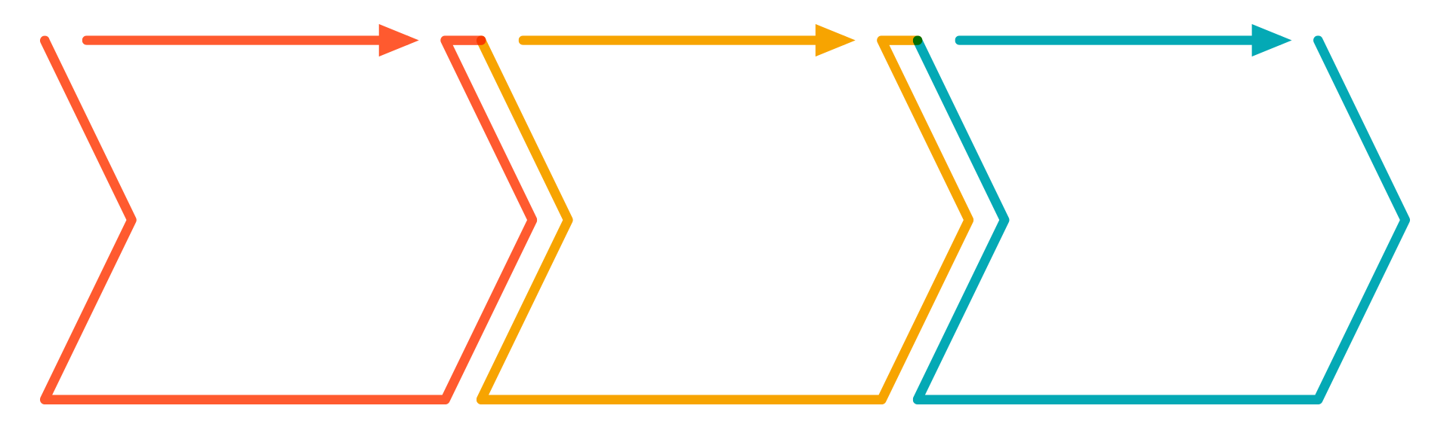
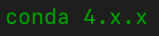
Everyone Do: Check Anaconda Installation
Check if Anaconda is properly installed
Open up terminal
2. Run
conda --version
and hit enter
3. Terminal output should return
Notes:
2.1
At the time this slide was built the latest version of conda was 4.8.3 - Please make sure to clarify to students that x has a variation depending when conda was downloaded and/or updated.
Please check https://docs.conda.io/projects/conda/en/latest/release-notes.html for latest versions.

Slide 15
Everyone Do: Create a Virtual Environment
In this activity, we will create a Virtual Environment with all right dependencies for future class activities.
10 Minutes
Notes:
2.2

Slide 16
Everyone Do: Create a Virtual Environment
What is a Virtual Environment?
Virtual environments create an isolated environment for Python projects.
You may be working on different projects that have different dependencies.
Different projects might also use different types and versions of libraries.
This virtual environment will make sure the class has all the right dependencies for future class activities.
Notes:
2.2 - NOTE: Follow the highlighted bullet points. Slides, LP and Notes are the same for this lesson.
Next move on to explaining virtual environments.
Virtual environments create an isolated environment for Python projects.
Explain how different projects can have different dependencies.
Explain how different projects might also use different types and versions of libraries.
This virtual environment will make sure the class has all the right dependencies for future class activities.
Create a virtual environment that will run Python 3.7. This will help solve issues where students have multiple versions of Python installed.
First run conda create -n PythonData python=3.7 anaconda in the terminal. Warn students that this may take a few minutes to install.
Now enter source activate PythonData to activate the environment. When (PythonData)$ appears, this means you are in the environment.
Now make sure everyone is using the correct version of Python by entering python --version.
Lastly, show that you can exit the environment by entering source deactivate. If source deactivate does not work, try using conda deactivate instead.
Remind students that they will need to activate their environment each time that they open a new terminal. Windows users should always use git-bash for their terminal.

Slide 17
Everyone Do: Create a Virtual Environment
How to create a Virtual Environment and activate it?
01
Create environment
02
Activate new environment
Notes:
2.2 - NOTE: Follow the highlighted bullet points. Slides, LP and Notes are the same for this lesson.
Next move on to explaining virtual environments.
Virtual environments create an isolated environment for Python projects.
Explain how different projects can have different dependencies.
Explain how different projects might also use different types and versions of libraries.
This virtual environment will make sure the class has all the right dependencies for future class activities.
Create a virtual environment that will run Python 3.7. This will help solve issues where students have multiple versions of Python installed.
First run conda create -n PythonData python=3.7 anaconda in the terminal. Warn students that this may take a few minutes to install.
Now enter source activate PythonData to activate the environment. When (PythonData)$ appears, this means you are in the environment.
Now make sure everyone is using the correct version of Python by entering python --version.
Lastly, show that you can exit the environment by entering source deactivate. If source deactivate does not work, try using conda deactivate instead.
Remind students that they will need to activate their environment each time that they open a new terminal. Windows users should always use git-bash for their terminal.

Slide 18
Everyone Do: Create a Virtual Environment
Check Python version in the new environment. Exit the environment.
03
Check Python version
04
Deactivate new environment
Notes:
2.2 - NOTE: Follow the highlighted bullet points. Slides, LP and Notes are the same for this lesson.
Next move on to explaining virtual environments.
Virtual environments create an isolated environment for Python projects.
Explain how different projects can have different dependencies.
Explain how different projects might also use different types and versions of libraries.
This virtual environment will make sure the class has all the right dependencies for future class activities.
Create a virtual environment that will run Python 3.7. This will help solve issues where students have multiple versions of Python installed.
First run conda create -n PythonData python=3.7 anaconda in the terminal. Warn students that this may take a few minutes to install.
Now enter source activate PythonData to activate the environment. When (PythonData)$ appears, this means you are in the environment.
Now make sure everyone is using the correct version of Python by entering python --version.
Lastly, show that you can exit the environment by entering source deactivate. If source deactivate does not work, try using conda deactivate instead.
Remind students that they will need to activate their environment each time that they open a new terminal. Windows users should always use git-bash for their terminal.

Slide 19
Variables
Notes:
3.1

Slide 20
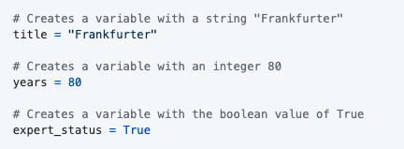
Variables
Similar to values stored in VBA cells
In Python, a value is being stored and given a name
Variables can store different data types like strings, integers and an entirely new data type called booleans which hold True or False values.
Notes:
3.1
Open up the file variables.py and explain to students that variables let us store information that we can later use.
Remind students how VBA accessed certain values when they referred to a specific cell. This is essentially what a variable is doing in Python, a value is being stored there.
Show the students the code and explain the following...

Slide 21
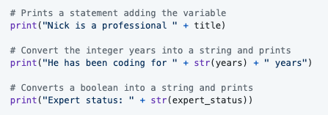
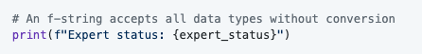
Print Statements
We can print statements which include variables, but traditional Python formatting won't concatenate strings with other data types. This means integers and booleans must be cast as strings using the str() function.
Alternatively, the "f-string" method of string interpolation allows strings to be formatted with different data types. Demonstrate the differences by refactoring the last print statement as an "f-string":
Notes:
3.1
Follow along with:
# Creates a variable with a string "Frankfurter"
title = "Frankfurter"
# Creates a variable with an integer 80
years = 80
# Creates a variable with the boolean value of True
expert_status = True
# Prints a statement adding the variable
print("Nick is a professional " + title)
# Convert the integer years into a string and prints
print("He has been coding for " + str(years) + " years")
# Converts a boolean into a string and prints
print("Expert status: " + str(expert_status))
# An f-string accepts all data types without conversion
print(f"Expert status: {expert_status}")

Slide 22
What time is it? It's showtime!
Nope! It’s time to check your
SLACK!
Notes:
Slack out the following reference guide for Python 3's f-Strings.

Slide 24
Activity: Hello Variable World!
In this activity, you will create a simple Python application that uses variables.
10 Minutes
Notes:
3.2

Slide 25
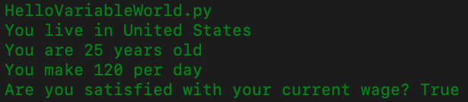
Activity: Hello Variable World!
Instructions:
Create two variables called name and country that will hold strings.
Create two variables called age and hourly_wage that will hold integers.
Create a variable called satisfied which will hold a boolean.
Create a variable called daily_wage that will hold the value of hourly_wage multiplied by 8.
Print out statements using all of the above variables to the console.
Notes:
3.2

Slide 26
Notes:
3.3

Slide 27
Inputs and Prompts
Notes:
4.1

Slide 28
Print Statements
We can print statements which include variables, but traditional Python formatting won't concatenate strings with other data types. This means integers and booleans must be cast as strings using the str() function.
Alternatively, the "f-string" method of string interpolation allows strings to be formatted with different data types. Demonstrate the differences by refactoring the last print statement as an "f-string":
Notes:
4.1
Follow along with:
# Creates a variable with a string "Frankfurter"
title = "Frankfurter"
# Creates a variable with an integer 80
years = 80
# Creates a variable with the boolean value of True
expert_status = True
# Prints a statement adding the variable
print("Nick is a professional " + title)
# Convert the integer years into a string and prints
print("He has been coding for " + str(years) + " years")
# Converts a boolean into a string and prints
print("Expert status: " + str(expert_status))
# An f-string accepts all data types without conversion
print(f"Expert status: {expert_status}")

Slide 29
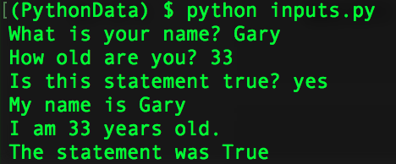
Inputs and Prompts
Notes:
4.1
Open inputs.py and then run the code within the terminal before opening the code up in the text editor.
# Collects the user's input for the prompt "What is your name?"
name = input("What is your name? ")
# Collects the user's input for the prompt "How old are you?" and converts the string to an integer.
age = int(input("How old are you? "))
# Collects the user's input for the prompt "Is input truthy?" and converts it to a boolean. Note that non-zero,
# non-empty objects are truth-y.
trueOrFalse = bool(input("Is the input truthy? "))
# Creates three print statements that to respond with the output.
print("My name is " + str(name))
print("I will be " + str(age + 1) + " next year.")
print("The input was converted to " + str(trueOrFalse))
Next explain how the code does the following...
Takes input from the command line after printing a prompt to the terminal.
The variable name will store the user's response to the prompt.
Every response to an input is stored as a string regardless of the characters entered. As such, variables that are intended to be integers must be cast to be used in calculations.
The bool() function always returns True if any text is inside of it (technically, any non-empty string will evaluate to True).
Print statements can be concatenated with variables so long as they are also strings or are cast as strings.

Slide 30
Notes:
Return to the lesson plan and continue with the instructions for the remainder of the activity.

Slide 31
Activity: Down the input
In this activity, you will work on storing inputs from the command line and run some code based upon the values entered.
10 Minutes
Notes:
4.2

Slide 32
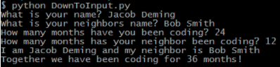
Activity: Down to Input
Instructions:
Create two different variables that will take the input of your first name and your neighbor's first name.
Create two more inputs that will ask how many months each of you has been coding.
Finally, display a result with both your names and the total amount of months coding.
Notes:
4.2

Slide 33
Notes:
4.3
Check LP or see below:
Open up the code contained within 06-Stu_DownToInput and go over the solution file line by line with the class, answering whatever questions students may have.
Key points to cover in discussing this code:
The variables your_first_name and neighbor_first_name are set using two inputs and, since they are strings, will not have to be cast later on.
The months_you_coded and months_neighbor_coded are set using two more inputs but have to be added together. As such, they will need to be cast as integers later on.
After calculating the total number of months, this new integer variable will have to be cast as a string to be printed.

Slide 34
Conditionals
Notes:
5.1

Slide 35
Conditionals
Few things to keep in mind!
Conditionals in Python carry nearly the same logic as in VBA. The primary difference is the syntax and indentation.
Python uses if, elif, and else for creating contionals.
Conditional statements are concluded with a colon but all lines after the colon must be indented to be considered a part of that code block. This is because Python reads blocks of code based on indentation.
All sorts of operators like greater than, less than, equal to, and much more can be used to create logic tests for conditionals.
The condition is equal to uses == while variable assignment uses one equal sign.
Multiple logic tests can be checked within a single conditional statement. Using the term and must mean both tests return True while or require that only one test return as true.
Conditionals can even be nested, allowing programmers to run logic tests based upon whether or not the original logic test returned as True.
Notes:
5.1
Open conditionals.py in a text editor and run through the code with the class.
Students should be familiar with conditionals after their time with VBA, so explain to them that the logic in Python is nearly the same. The primary difference is the syntax and indentation.
Python uses if, elif, and else for creating conditionals (pay attention to the letter case and spelling!).
Conditional statements are concluded with a colon but all lines after the colon must be indented to be considered a part of that code block. This is because Python reads blocks of code based on indentation.

Slide 36
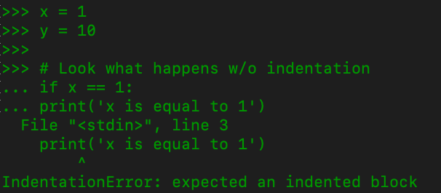
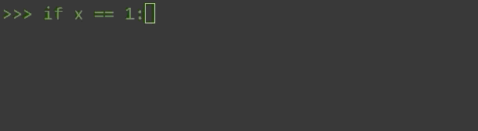

Conditionals
Indentation matters in Python!
Hint: count four ‘space’ stroke on your keyboard or hit ‘tab’ once
Notes:
5.1
Show students how indentation in Python is crucial.

Slide 37
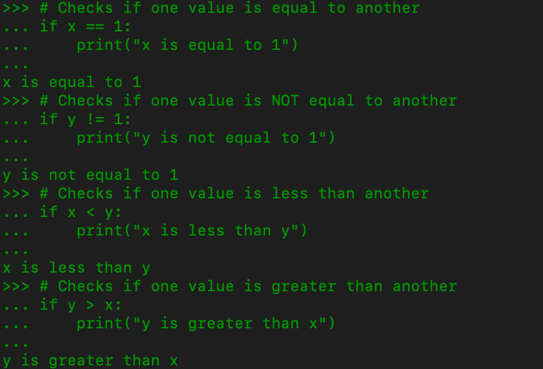
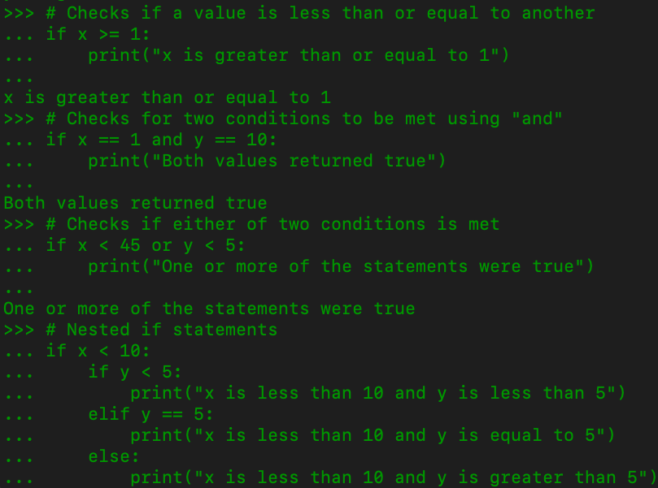
Conditionals
Notes:
5.1
Slide 36 continuation...

Slide 39
Activity: Conditional Conundrum
In this activity, you will be looking through some pre-written conditionals and attempting to figure out
10 Minutes
Notes:
5.2
Slack out the solution above and then ask the class if anyone would like to share their creations from the bonus section of the activity.
Have students slack out their code and then explain how their conditional puzzles worked with the class.

Slide 40
Activity: Conditional Conundrum
Instructions:
Look through the conditionals within the provided code and figure out which lines will be printed to the console.
Do not run the application at first, see if you can follow the thought process for each chunk of code and then place a guess. Only after coming up with a guess for each section should you run the application.
Bonus:
After figuring out the output for all of the code chunks, create your own series of conditionals to test your fellow students. Once you have completed your puzzle, slack it out to everyone so they can test it.
Notes:
5.2

Slide 41
Notes:
5.3
Check LP or see below:
Open up the code contained within 08-Stu_conditionalConundrum and go over the solution file line by line with the class, answering whatever questions students may have.
Key points to cover during this discussion:
The if statement for the first code chunk checks whether 10 > 10, which is false. As such the code will return "ooo needs some work".
The length of "Dog" is 3 and x is 5, thus making the statement for the second chunk of code true and returning "Question 2 works!"
The addition of the and statement to the third chunk of code means both logic tests need return True to run. Thankfully both do and thus "GOT QUESTION 3!" is printed.
Conditionals work by going form the top down. The logic tests in chunk four do not return as True until the third conditional and, as such, "Dan is in group three" is printed.
Within chunk five, one of the conditions are met in the third conditional, but it's not until getting into the or statement of the fourth conditional that the logic test finally returns as True.
Slack out the solution above and then ask the class if anyone would like to share their creations from the bonus section of the activity.
Have students slack out their code and then explain how their conditional puzzles worked with the class.
The length of "Dog" is 3 and x is 5, thus making the statement for the second chunk of code true and returning "Question 2 works!"
The addition of the and statement to the third chunk of code means both logic tests need return True to run. Thankfully both do and thus "GOT QUESTION 3!" is printed.
Conditionals work by going form the top down. The logic tests in chunk four do not return as True until the third conditional and, as such, "Dan is in group three" is printed.
Within chunk five, one of the conditions are met in the third conditional, but it's not until getting into the or statement of the fourth conditional that the logic test finally returns as True.

Slide 42
What time is it? It's showtime!
Nope! It’s time to check your
SLACK!
Notes:
Slack out the solution above and then ask the class if anyone would like to share their creations from the bonus section of the activity.
Have students slack out their code and then explain how their conditional puzzles worked with the class.

Slide 43

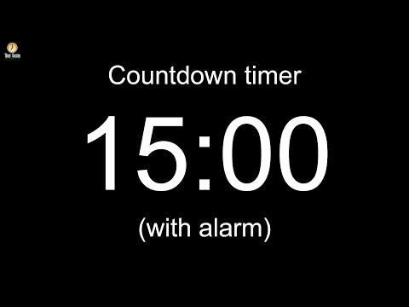
Notes:
-------------------
Image source: AdobeStock_56885471

Slide 44
Lists
Notes:
6.1

Slide 45
Lists
Couple of points to keep in mind before we move forward
Lists are the Python equivalent of arrays in VBA, functioning in much the same way by holding multiple pieces of data within one variable.
Lists can hold multiple types of data inside of them as well. This means that strings, integers, and boolean values can be stored within a single list.
Notes:
6.1
Welcome students back from break and let them know that the next data type they will be uncovering are lists.
Lists are the Python equivalent of arrays in VBA, functioning in much the same way by holding multiple pieces of data within one variable.
Lists can hold multiple types of data inside of them as well. This means that strings, integers, and boolean values can be stored within a single list.

Slide 46
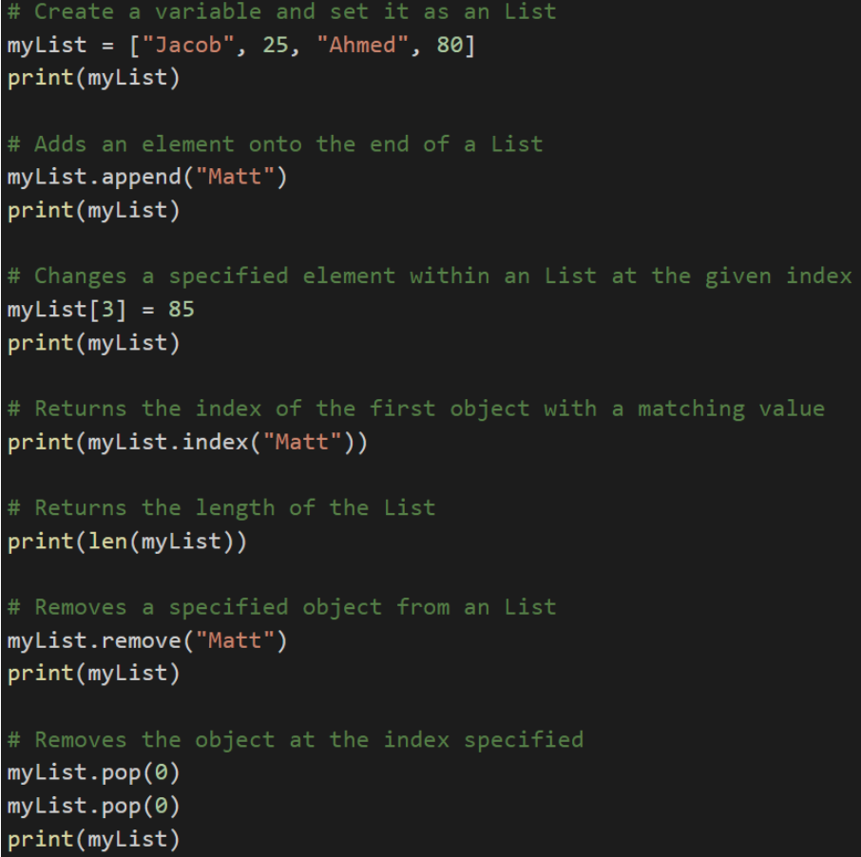
Lists Methods in Python
Python has a set of built-in methods that you can use on lists
The append method can add elements on to the end of a list.
The index method returns the numeric location of a given value within a list.
The len function returns the length of a list.
The remove method deletes a given value from a list.
The pop method can be used to remove a value by index.
Notes:
6.1
Open lists.py and explain how a list called myList was created that contains a mix of data types.
The append method can add elements on to the end of a list.
The index method returns the numeric location of a given value within a list.
The len function returns the length of a list.
The remove method deletes a given value from a list.
The pop method can be used to remove a value by index.
Remind students that indexing in lists starts at 0.

Slide 47
Tuples
Tuples are functionally similar to lists in what they can store but are immutable
While lists in Python can be modified after their creation, tuples can never be modified after their declaration.
Tuples tend to be more efficient to navigate through than lists and also protect the data stored within from being changed.
Notes:
6.1
Python also has a data type called "tuples" that are functionally similar to lists in what they can store but are immutable.
While lists in Python can be modified after their creation, tuples can never be modified after their declaration.
Tuples tend to be more efficient to navigate through than lists and also protect the data stored within from being changed.
For more info on tuples, have your students check this quora question out.

Slide 48
Notes:
Return to the lesson plan and continue with the instructions for the remainder of the activity.

Slide 49
Activity: Rock, Paper, Scissors
In this activity, you will be creating a simple game of Rock, Paper, Scissors that will run within the console.
15 Minutes
Notes:
6.2

Slide 50
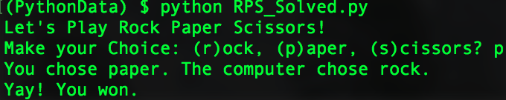
Activity: Rock, Paper, Scissors
Instructions:
Using the terminal, take an input of r, p or s which will stand for rock, paper, and scissors.
Have the computer randomly pick one of these three choices.
Compare the user's input to the computer's choice to determine if the user won, lost, or tied.
Notes:
6.2
Trigger student’s instinct to ‘troubleshoot’ on their own.
Instead of giving the students the answer, hint that the results are easily found using google. If you notice any struggle you can hint stackoverflow. The optimal link for random is https://stackoverflow.com/questions/306400/how-to-randomly-select-an-item-from-a-list
Open RPS_Unsolved.py within a text editor and tell students that this will be their starter code.
Explain how the code imports a module called random that will allow the computer make a choice randomly from a list of actions.
Mention to the class how they will be diving far more deeply into modules during the next class.
Direct them towards the documentation for the random module and explain how, by importing the random library, they will now have access to all these functions within their code.

Slide 51
Notes:
6.3
Check LP or see below:
Open up the code contained within RPS_Solved.py and go over the solution file line by line with the class, answering whatever questions students may have.
Key points to cover when discussing this activity:
In the starter code, random.choice will pick a random choice within the options list for the computer and store its pick within a variable called computer_choice.
The application prompts the user for their option and stores it within a variable called user_choice.
Knowing that rock beats scissors, scissors beats paper, and paper beats rock the code can be organized into a series of conditional statements to compare the user's choice to the computer's choice.

Slide 52
Loops
Notes:
7.1

Slide 53
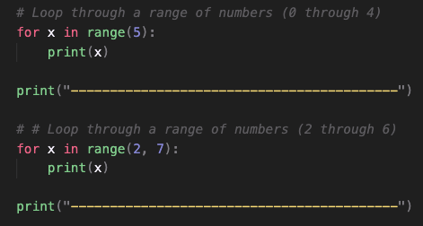
Loops
Loops is also a concept we covered during VBA!
The variable x is created within the loop statement and could theoretically take on any name so long as it is unique.
When looping through a range of numbers, Python will halt the loop one number before the final number. For example, when looping from 0 to 5, the code will run five times, but x will only ever be printed as 0 through 4.
When provided with a single number, range() will always start the loop at 0. When provided with two numbers, however, the code will loop from the first number until it reaches one less than the second number.
Notes:
7.1
The next topic, loops, was also covered during VBA but students may still struggle with grasping the syntax in Python, so make sure to field questions as you proceed through the activity.
Open up 11-Ins_Loops within a text editor and explain the following...
The variable x is created within the loop statement and could theoretically take on any name so long as it is unique.
When looping through a range of numbers, Python will halt the loop one number before the final number. For example, when looping from 0 to 5, the code will run five times, but x will only ever be printed as 0 through 4.
When provided with a single number, range() will always start the loop at 0. When provided with two numbers, however, the code will loop from the first number until it reaches one less than the second number.

Slide 54
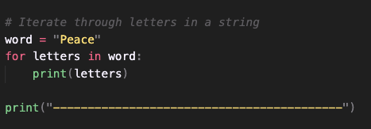
Looping through strings
Python can also loop through all of the letters within a string
The syntax is for <variable> in <string>:
Notes:
7.1

Slide 55
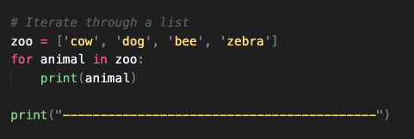
Looping through lists
Python can also loop through all of the values within a list
The syntax is for <variable> in <list>:
Notes:
7.1

Slide 56
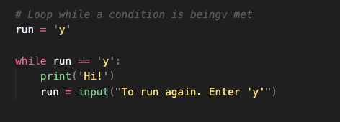
While loops
Just like a for loop but will continue looping for as long as a condition is met
Notes:
7.1

Slide 57
Activity: Number Chain
In this activity, you will take user input and print out a string of numbers.
15 Minutes
Notes:
7.2

Slide 58
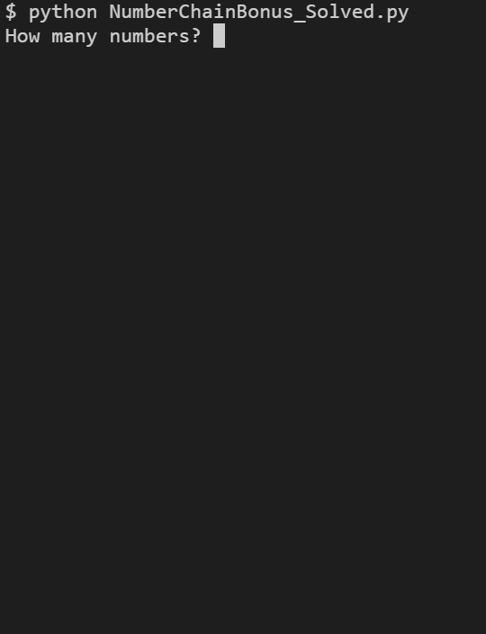
Number Chain
Instructions:
Using a while loop, ask the user "How many numbers?", and then print out a chain of ascending numbers from 0 to the number input.
After the results have printed, ask the user if they would like to continue. If "y" is entered, keep the chain running by inputting a new number and starting a new count from 0 to the number input. If "n" is entered, exit the application.
Bonus
Rather than just displaying numbers starting at 0, have the numbers begin at the end of the previous chain.
Notes:
7.2

Slide 59
Notes:
7.3
Check LP or see below:
Open up the code contained within NumberChain_Solved.py and go over the solution file line by line with the class, answering whatever questions students may have.
For the regular solution explain:
The initial value for user_play is set to "y" so that the while loop will run initially. This loop will continue to run so long as the value of user_play is "y" at the end of the code block.
An input number is asked for and then a for loop will then run to count from 0 to that number.
The user is then prompted to either enter "y" if they would like to create a new number chain or "n" if they would like to terminate the application.
For the bonus solution, just add in a variable called start_number whose initial value is 1 and whose value will be set to the last number used in the loop after the for loop has completed.
The for loop will now run from the range of start_number to user_number plus start_number. This means that the code will always count up the inputted amount from the previous input amount.

